Slide 1
WV NEBP Mission Concept and System Requirements
03/03/2023
DRAFT
Marcus Fisher (mfisher@tcswv.org)

Slide 2
Contents
Development Approach
Problem Statement and Mission Goals
Domain Model (Block Definition Diagram (BDD))
Logical Architecture (Internal Block Diagram (IBD))
System-Level Use Cases
System Requirements
System State Machine
System Behaviors within Each State
Failure Modes and Effects Analysis
Acceptance Tests

Slide 3
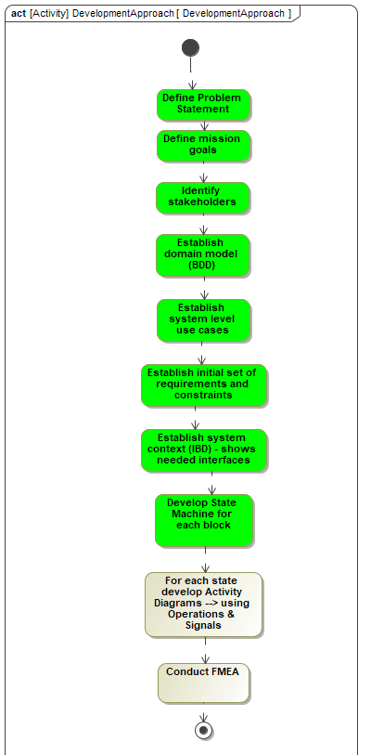
Development Approach
A logical flow of activities with engineering artifacts as the output
Really not implemented in linear manner
System Requirements, State Machine, and Behaviors within each state are continuously being updated
Current Status

Slide 4
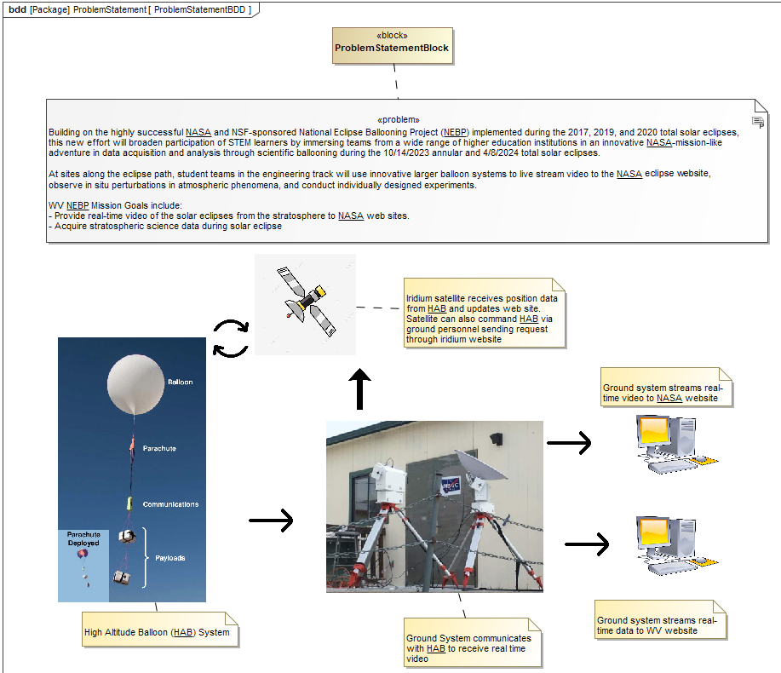
Problem Statement & Goals

Slide 5
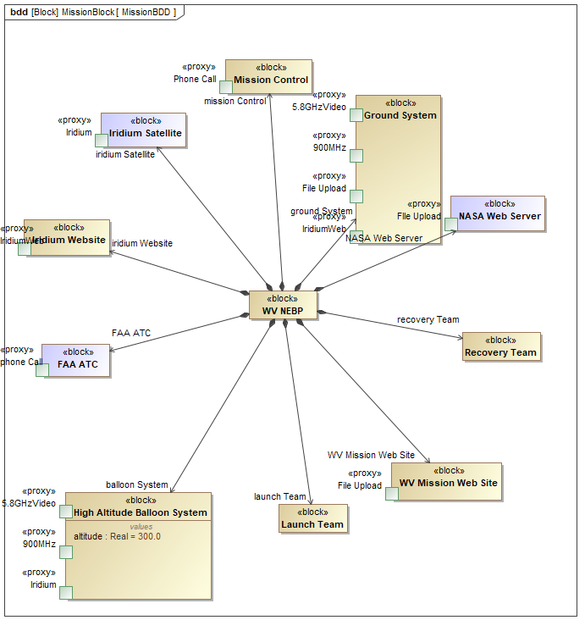
Domain Model (BDD)
Depicts what subsystems make up our system
Purple blocks are systems outside the scope of our development

Slide 6
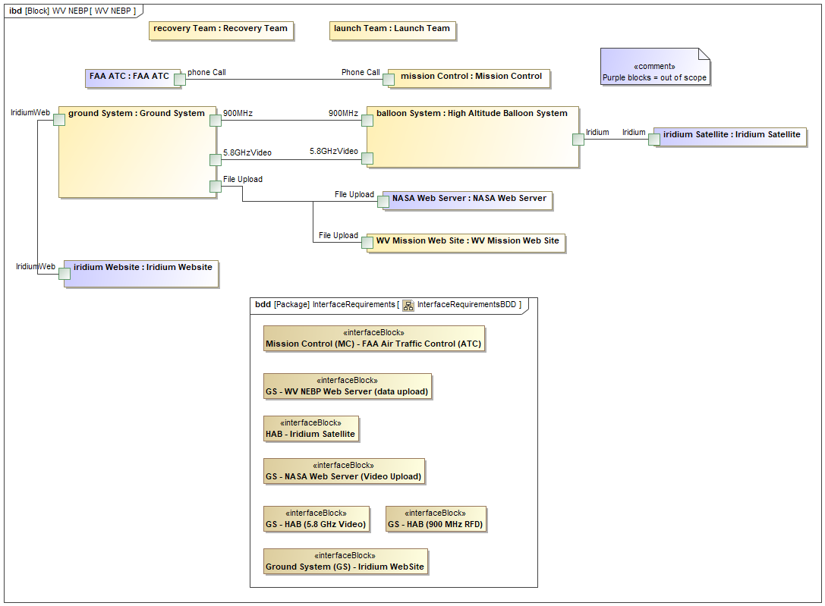
Logical Architecture (IBD) and Required Interfaces
Depicts HOW our subsystems are connected together.
Each port on a block indicates an interface

Slide 7
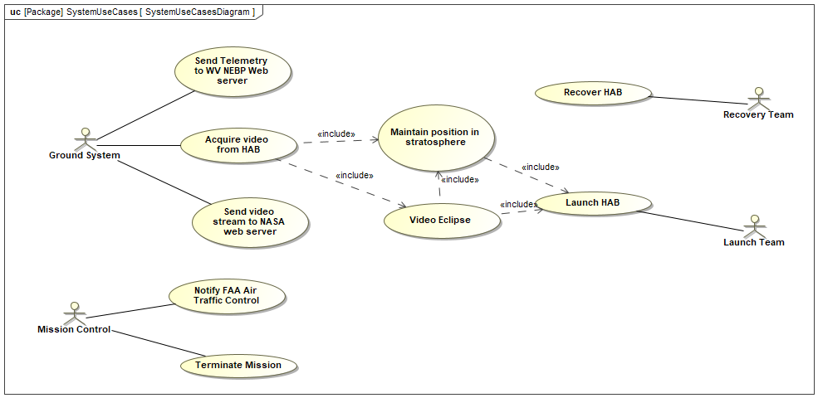
System-Level Use Cases
Use depict how the system will be used and help drive the identification of requirements

Slide 8
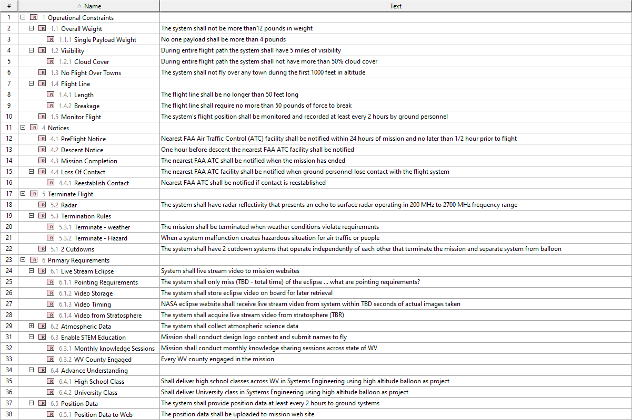
System Requirements
Needs Updated AFTER state machine completed

Slide 9
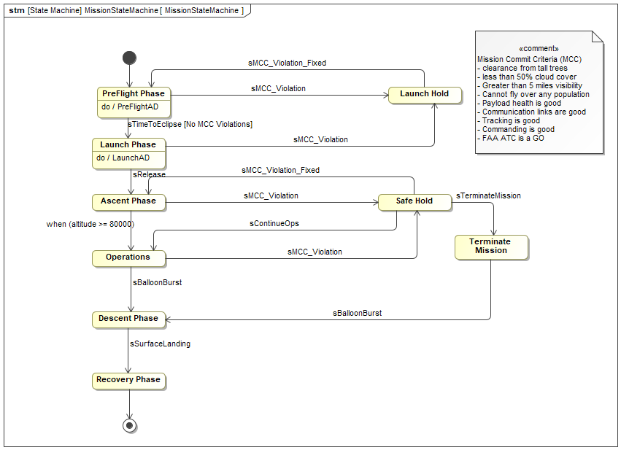
Mission State Machine
Depicts how the mission will operate and the various states and logic that controls state transitions

Slide 10
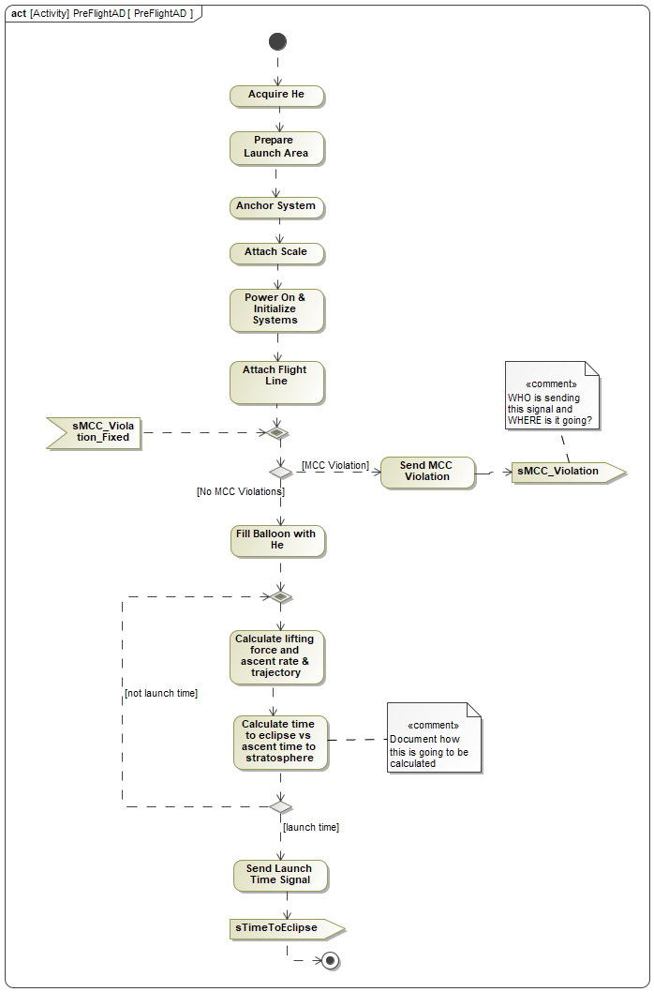
Preflight Phase State - Behavior
These are the system behaviors that are being realized during Preflight Phase State
The state machine and the behaviors within each state help identify the needed system requirements

Slide 11
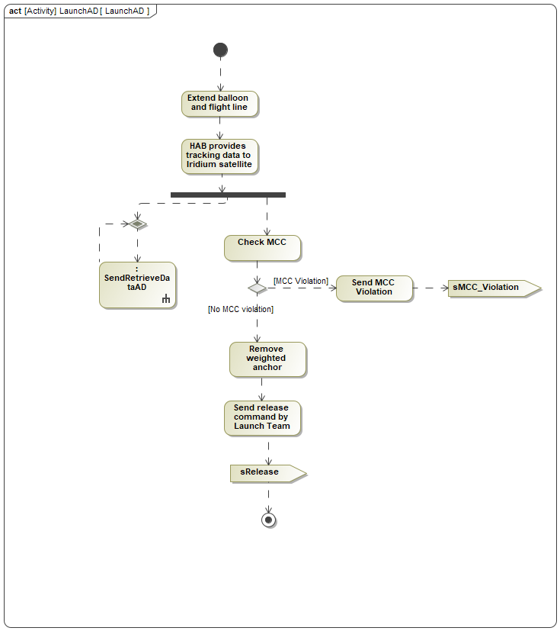
Launch Phase State

Slide 12
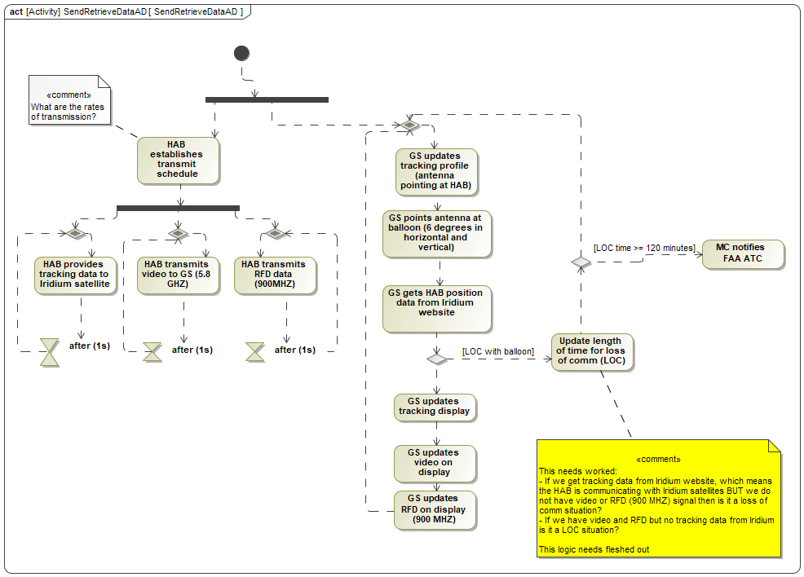
Send & Retrieve Data

Slide 13
What Next
Remaining states and their associated behaviors need developed
Several questions in the model need worked (e.g., what does LOC do?)
FMEA needs developed (or Fault Tree) to understand highest areas of risk
Acceptance Tests need developed
We will conduct a review over coming weeks
After review … each subsystem team (e.g. Ground System) can then start developing their own engineering artifacts

Slide 14
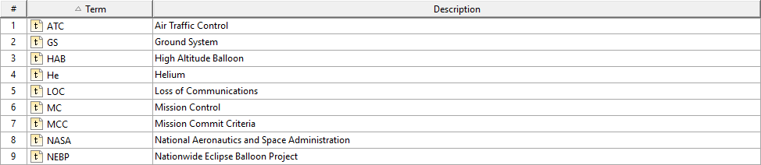
Glossary and Acronyms

